Slide 1
SPEECH
VIDISHA KASHYAP

Slide 2
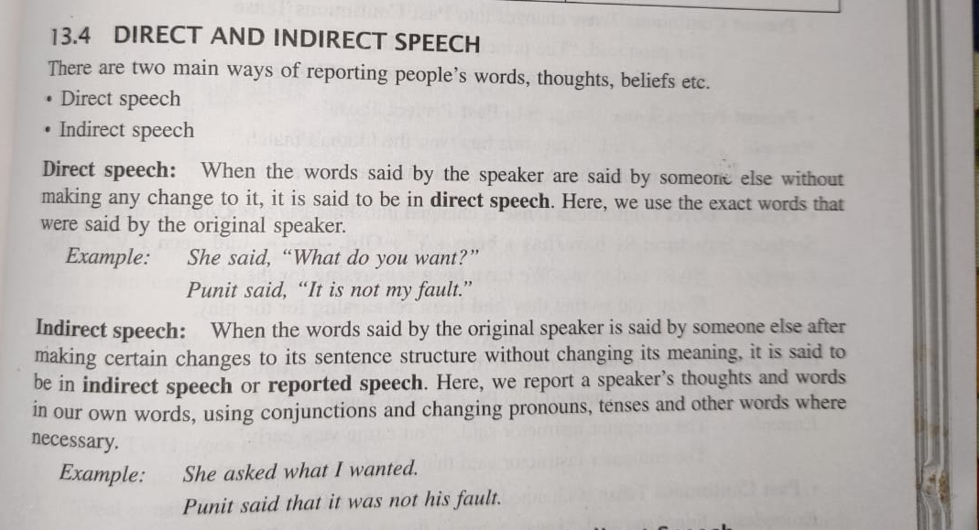

Slide 3
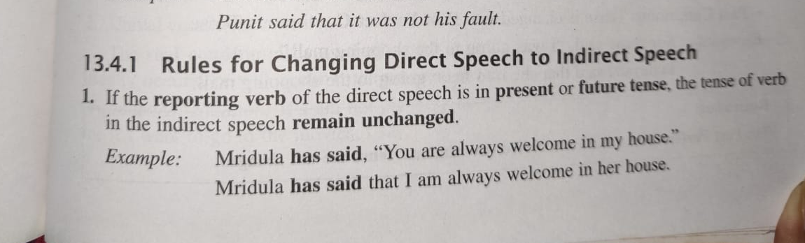
RULES FOR CHANGING DIRECT SPEECH TO INDIRECT SPEECH

Slide 4
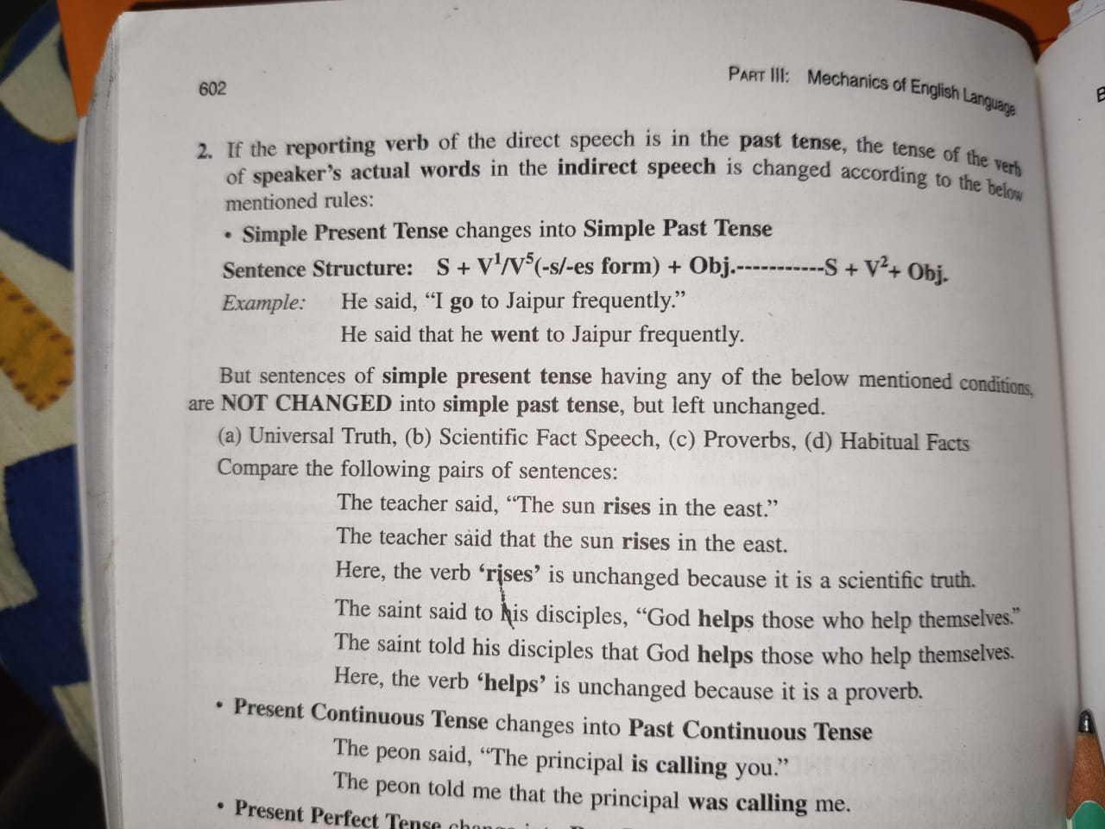

Slide 5
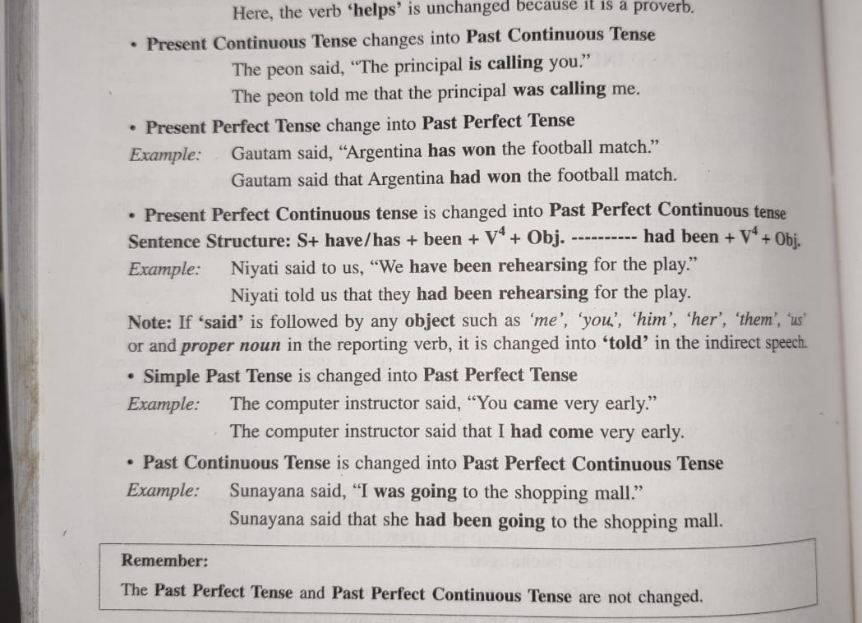

Slide 6
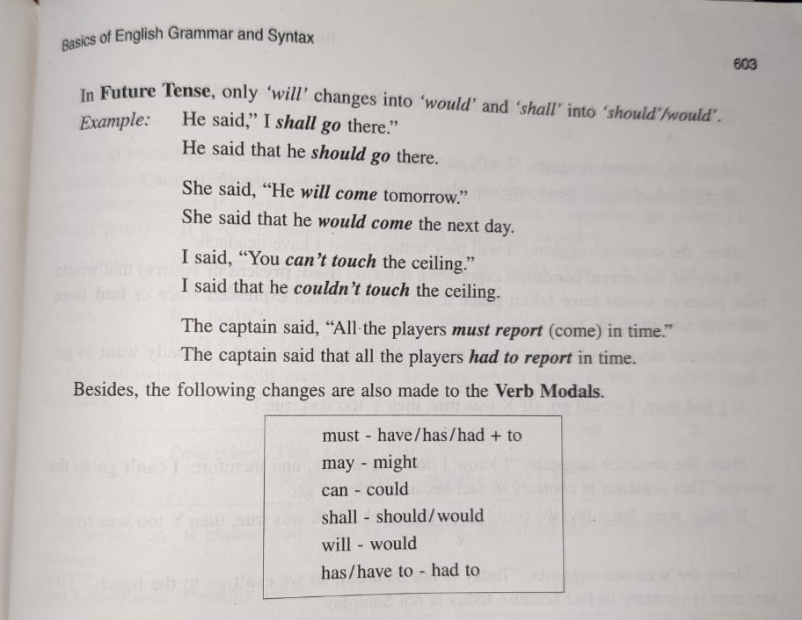

Slide 7
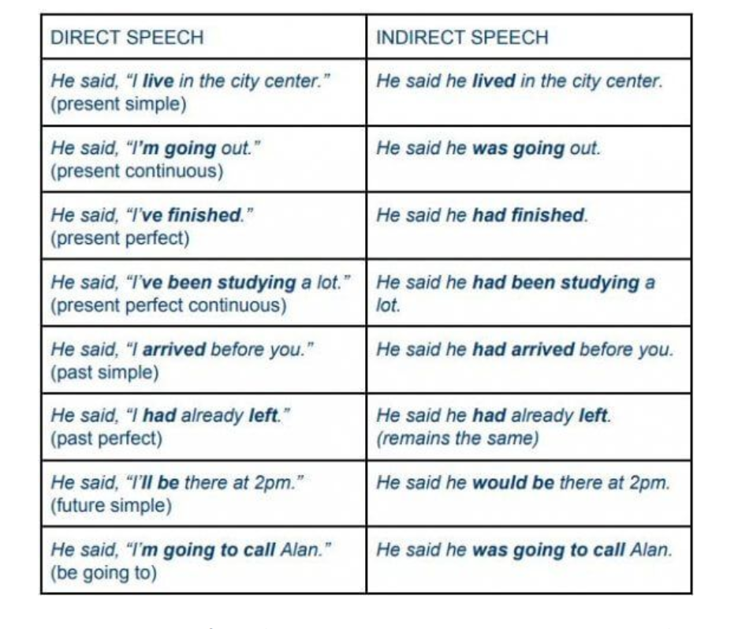

Slide 8


